Slide 1
Multiplayer web games
A Guide on how to use socket io in conjunction with three js to create a multiplayer game.

Slide 2
Design
We will follow a client server model when designing our networking
This means if client a wants to communicate with client be they must send a message to the server who will relay that message to the appropriate client
We will use a client authoritative model, trust the client.

Slide 3
Library
We will be using socket io to do our networking. Socket io is a library which makes working with websockets super easy and convenient.

Slide 4
What is a socket
A socket is a communication protocol allowing for a persistent two-way connection between devices facilitating real time data transfer.

Slide 5
80 / 20 rule
The 80 / 20 rule states that 80% of outcomes come from 20% of causes.
In the case of socket io there is just a few functions (20%) that are used very commonly across the project (80%). So if you can know these few functions you will have enough knowledge to create a multiplayer game.
So what are these functions?

Slide 6
Client Functions

Slide 7
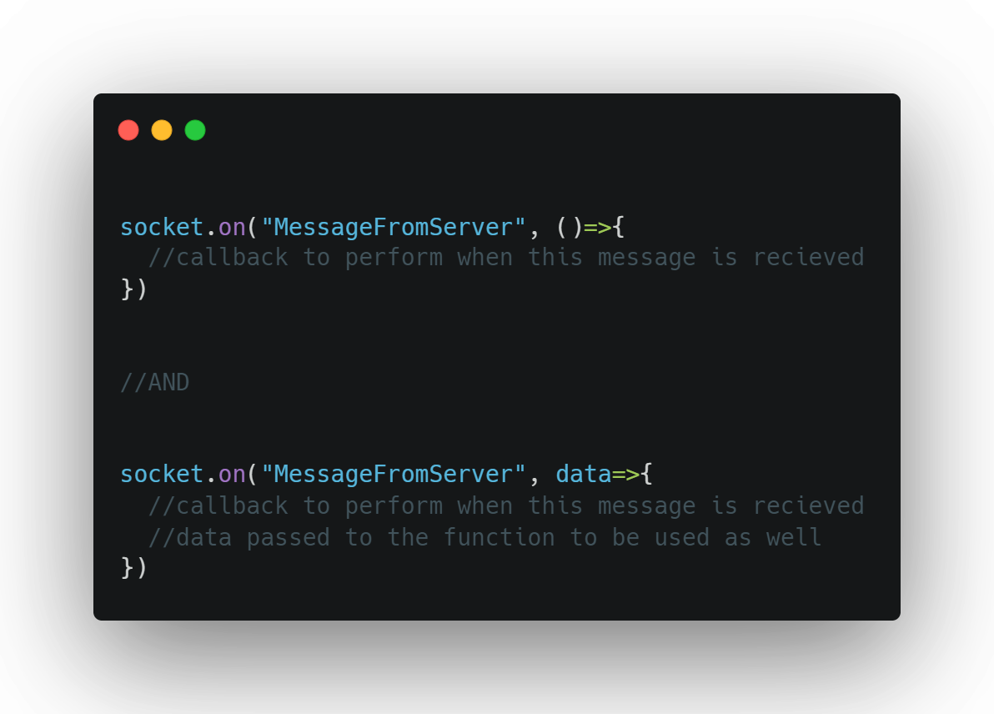
Assume socket here is an object accessible from this scope
This is how to react to messages from the server

Slide 8
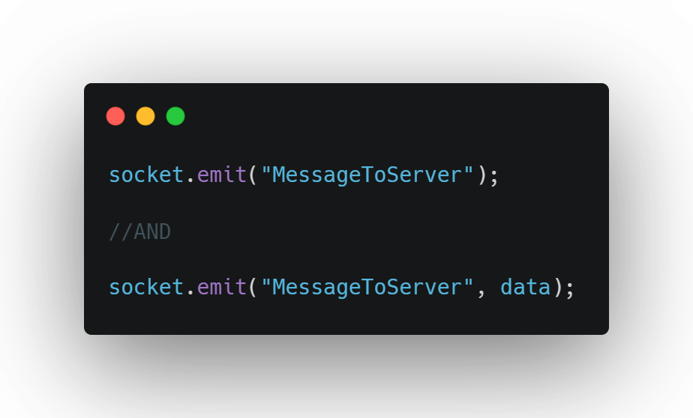
Assume socket here is an object accessible from this scope
This is how to send messages to the server

Slide 9
THAT’S IT!
For your client’s code at least

Slide 10
Server Side Functions

Slide 11
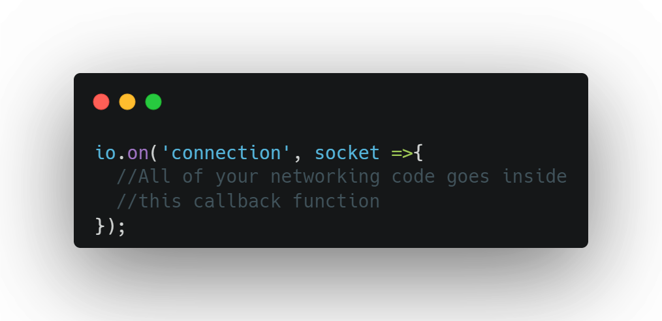
Assume io here is an object accessible from this scope
Notes:
What this does is assigns an event listener to react to a socket connecting to the server.
This callback will be ran for each socket when they connect to the server. Each socket represents a two way communication between server and client

Slide 12
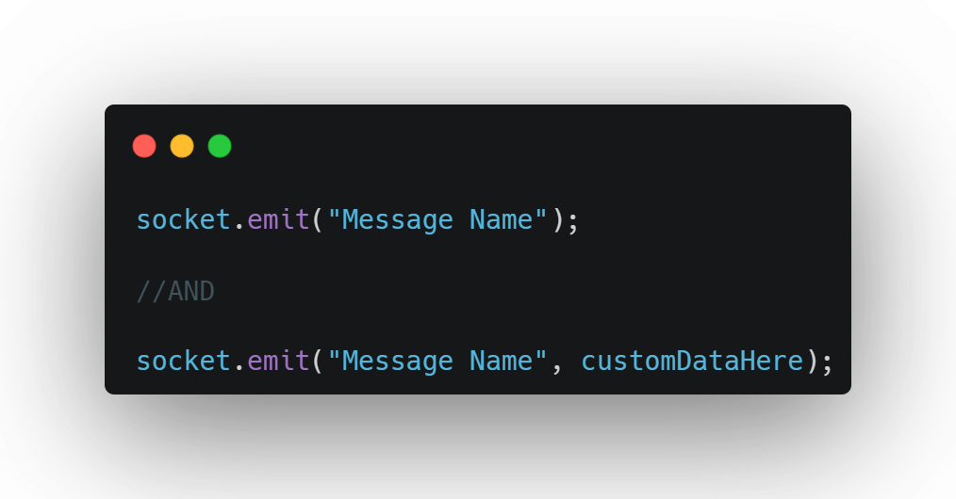
Assume socket here is an object accessible from this scope

Slide 13
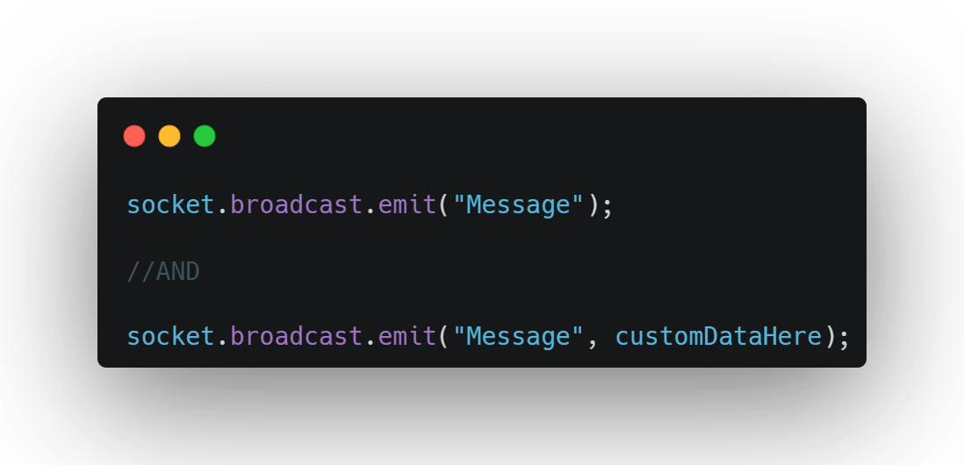
Assume socket here is an object accessible from this scope

Slide 14
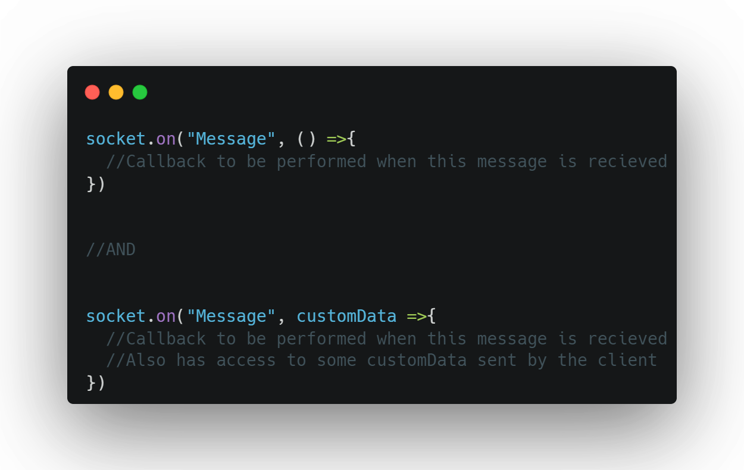
Assume socket here is an object accessible from this scope

Slide 15
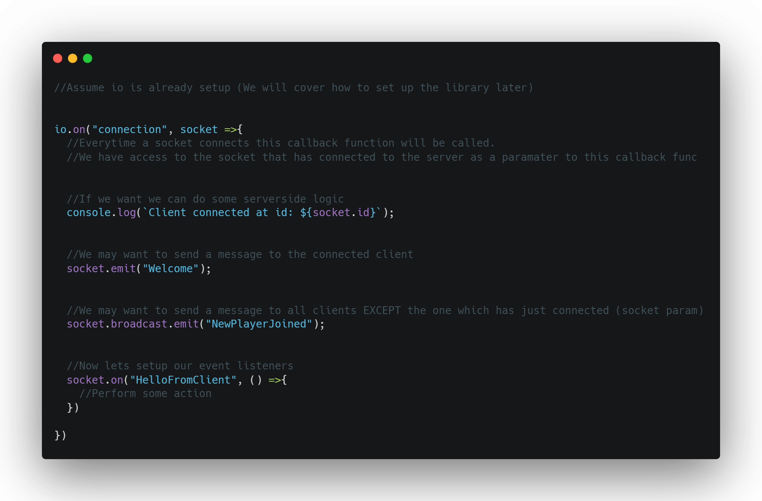
All Together

Slide 16
Quick recommendation before we start
I used Jetbrains Rider as my ide for this
And it was leagues above any other ide’s that ive used so far.
It actually has IntelliSense you can be confident in and also has IntelliSense for all the THREEjs symbols which was very useful.
Its recently became free via a community licence but is also available to students
So yeah… get rider its great!

Slide 17
Demo Scene

Slide 18
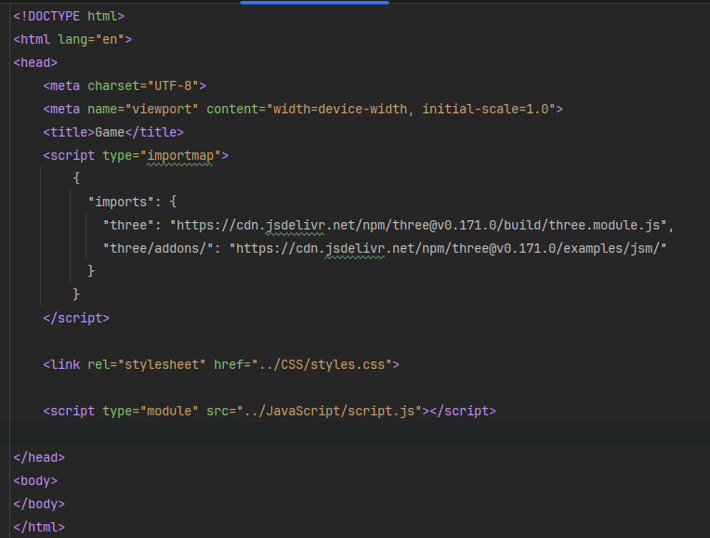
How it's made part 1 setting up the scene
In this step we will just get the three js hello world up and running and served from express.
So well make an index html file with a link to a css file, javascript file and an import map to import all our three js dependencies
Very simple stuff we've seen before

Slide 19
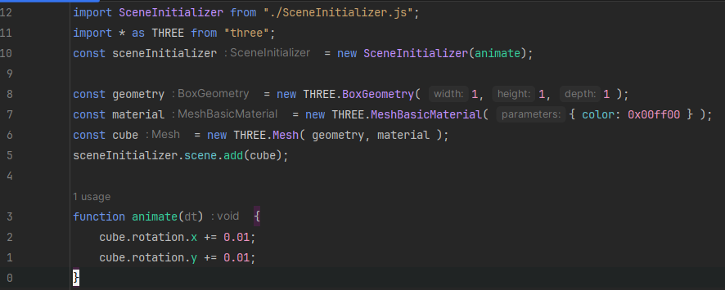
How it's made part 1 setting up the scene
Next we’ll get some javascript in to get a cube spinning
You may notice that my main file is very small (12 lines). This is intentional, all the complexities of setting up a scene is all handled by the sceneInitializer.
All of your networking code is going to be in this file so keeping your code clean by separating it out into different files and classes will really be worth the time it takes.

Slide 20
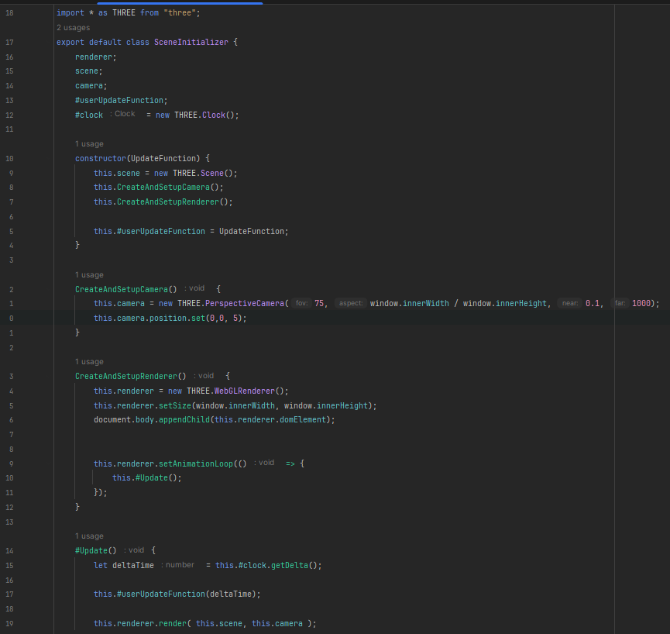
How it's made part 1 setting up the scene
Just for reference here is the SceneInitializer.
It has a few member variables but essentially just sets three js up for us so its ready to be used leaving our main file clean

Slide 21
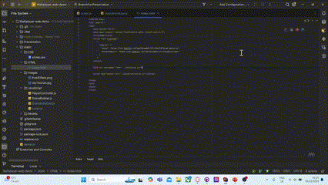
Run with live server
So when we run this using a live server from our ide we can see our three js scene rendering

Slide 22
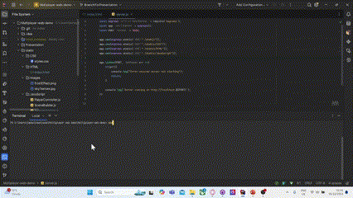
Next serve these files with express (server)

Slide 23
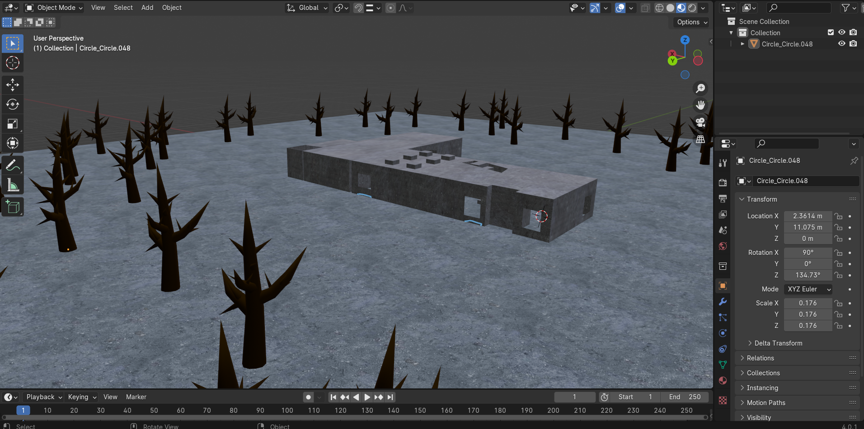

Now lets make our scene look pretty…
Well make a scene in blender and export everything into a gltf
This is contained in the static folder with
Your other client resources like
Sky sphere textures and source code

Slide 24
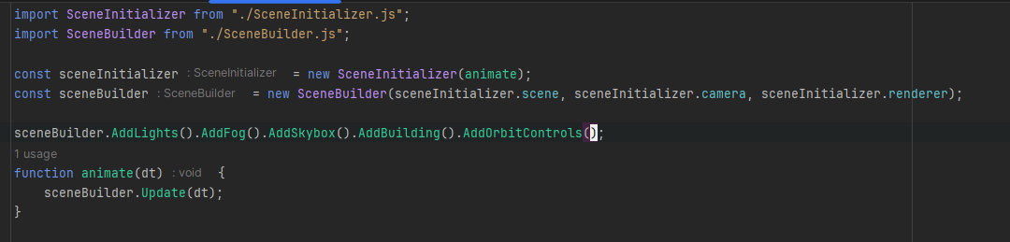
Getting it into three.js
So in our main js were going to import our SceneBuilder class (which ill show in a sec), create a new instance of a sceneBuilder and chain together a bunch of methods to build our scene in one line.
Well also call scene builders update function in our animate function. This way any objects like our orbit controller for example can be updated

Slide 25
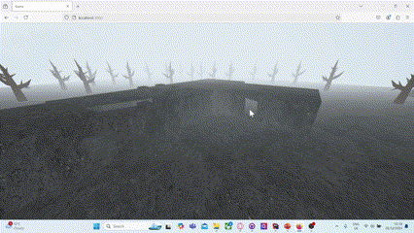

Slide 26
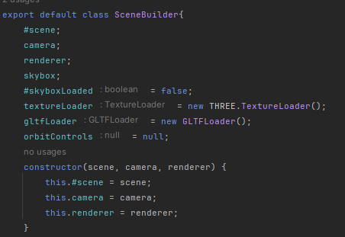
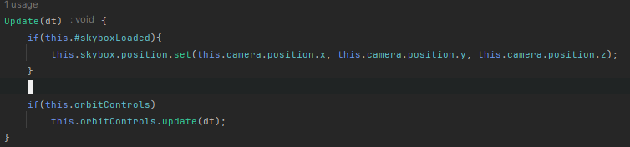
Scene Builder
The scene builder is composed of some useful member variables, a simple constructor, an update function and…

Slide 27
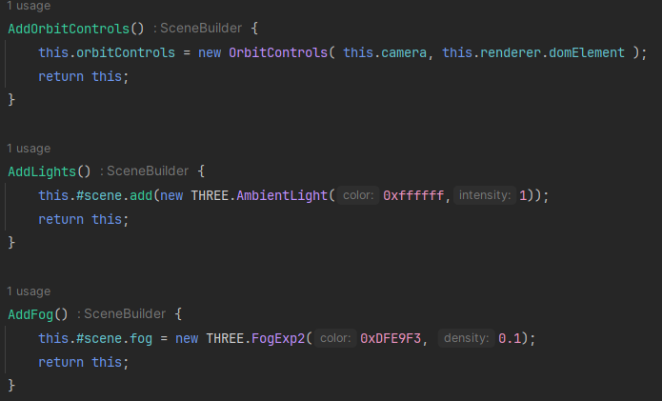
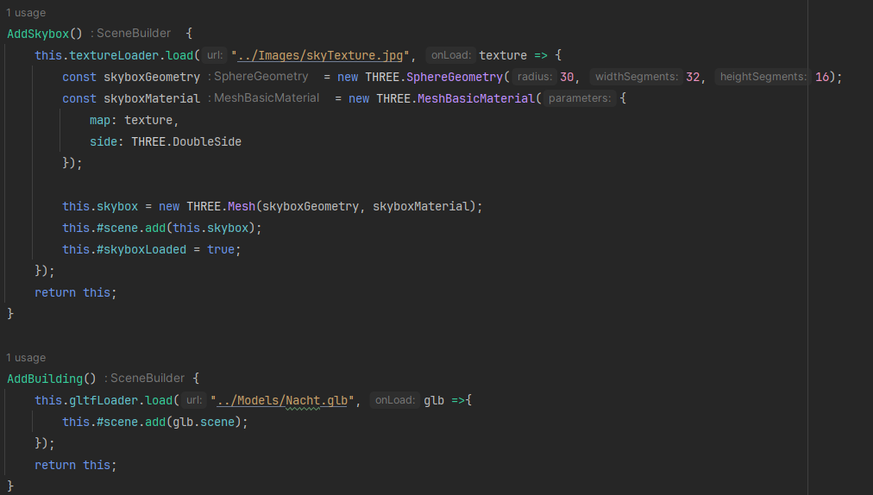
And…
a bunch of chainable methods which allow us to build our scene by adding a bunch of smaller parts to our scene

Slide 28
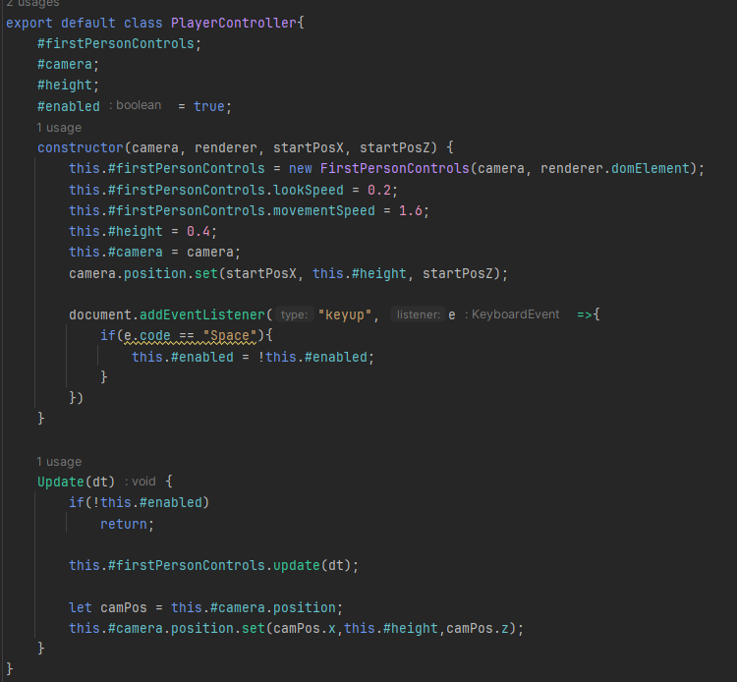
Okay the last thing we've got to do is get a player controller in
This player controller is just a wrapper around the FirstPersonControls class provided by three js.
The only additions made by this class to the FirstPersonControlls class from THREE.js are
the y axis is fixed
You can enable / disable the FirstPersonControls by pressing space

Slide 29
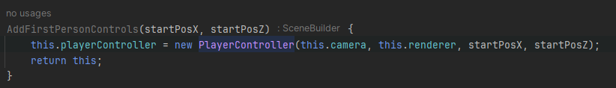
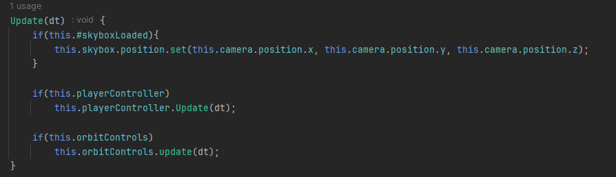



We can make a small change to our scene builder to give it the ability to add a player controller into our scene

Slide 30



Now we can swap out our orbit controls for our first person controls

Slide 31
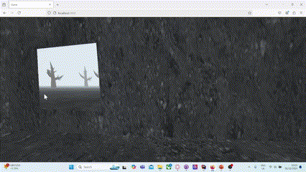
Yipeeee
Also if anyone could tell me what environment I have recreated here that would make me very happy 😉
We have now constructed a base project which we can make multiplayer.

Slide 32
The aim will be to have two clients able to connect to the server and see each other walk around. A client can leave and join back at any time.
A limitation of the system we will build is that it will be made for only 2 clients to connect at once you will have to think or experiment yourselves if you want more than 2 clients 😉

Slide 33
Time to make it multiplayer!!

Slide 34
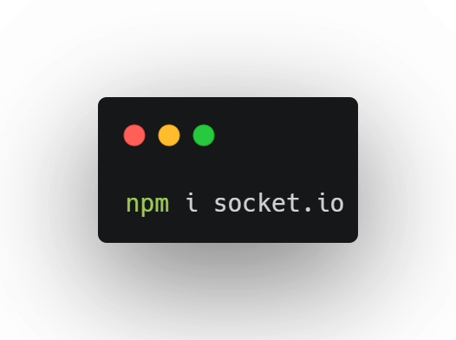
Server
First we will use npm to install socket io

Slide 35
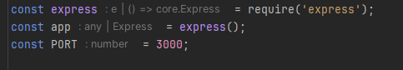
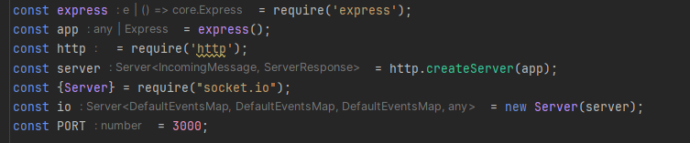
Now lets edit our server code
We will add a layer over the top of our express server to make the server an express and socket io server

Slide 36
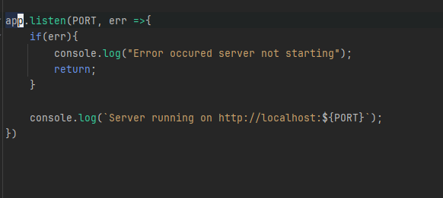
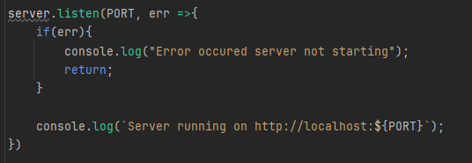
Now lets edit our server code
Instead of app.listen to start our server we can use server.listen

Slide 37
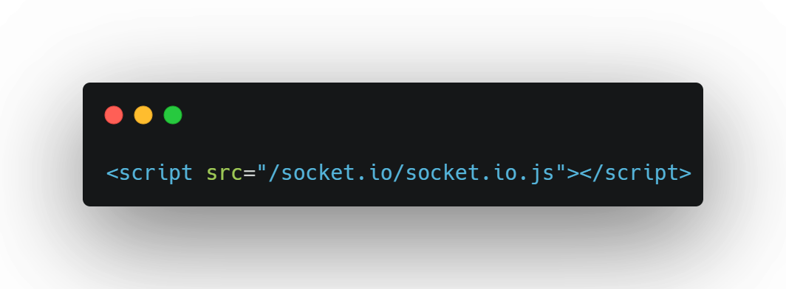
Next add socket io to the client

Slide 38
Okay now we are ready to start using the library!

Slide 39
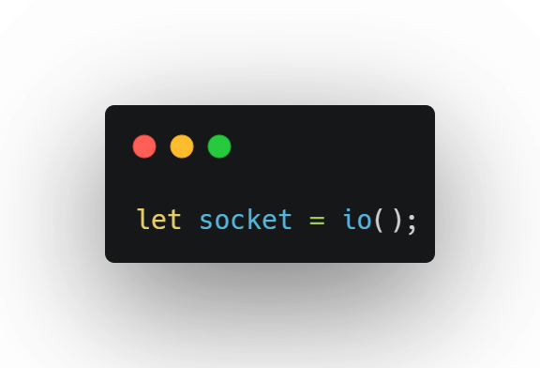
Initialize in our script

Slide 40
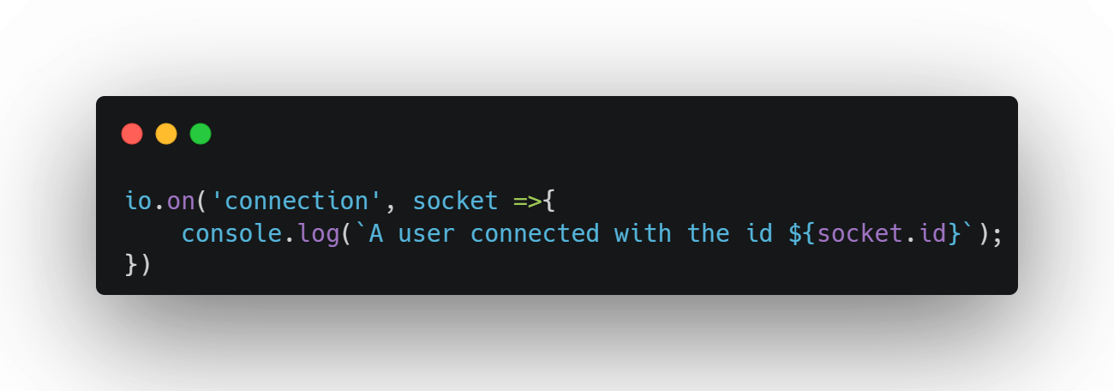
Add this to our server

Slide 41
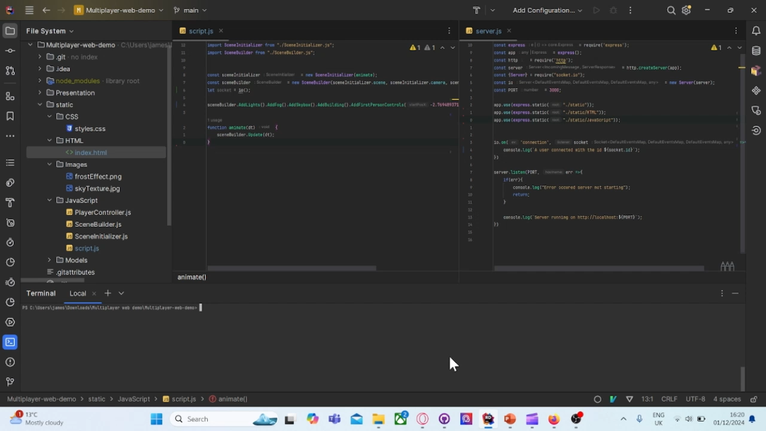
Test

